Slide 1
ICN MLI
January 13-15, 2015
ML Bootcamp: Introduction to Deep Learning
Tassilo Klein
Image credits: bestfreejpg.com

Slide 2
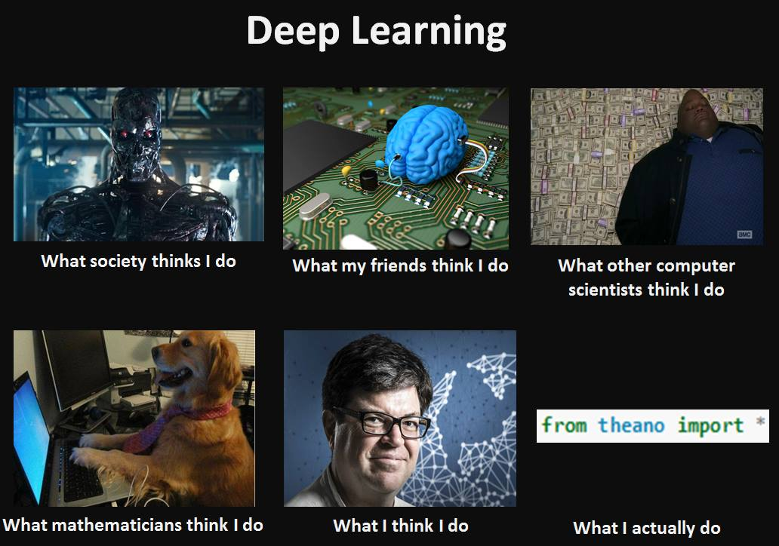

Slide 3


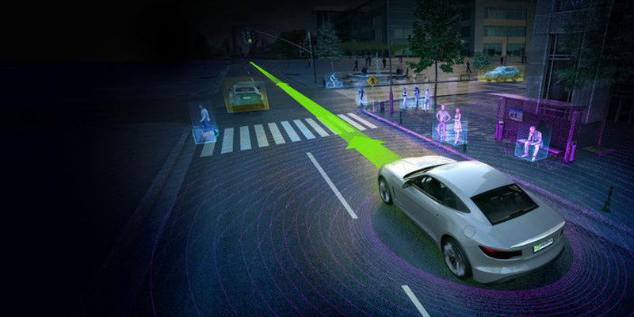
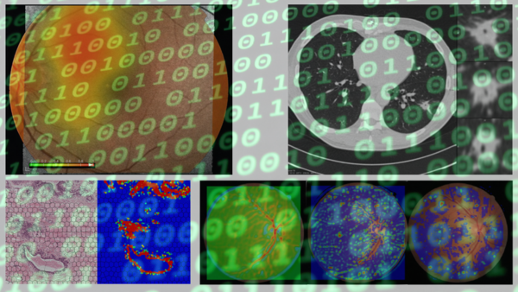
Deep Learning recent success and future

Slide 4

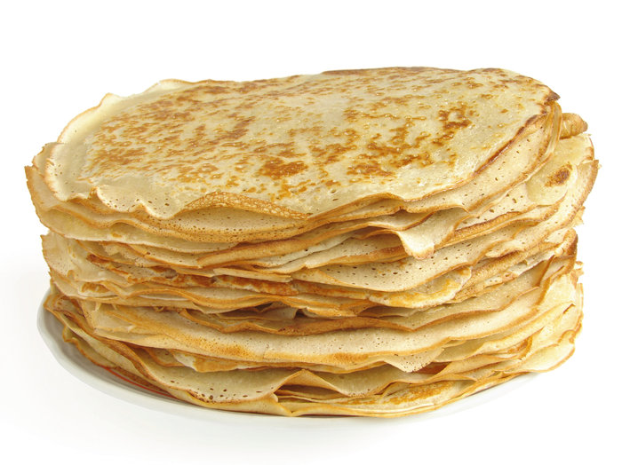
What is Deep Learning?
The Essence of Deep Learning (DL):
Branch of machine learning
More or less rebranding of neural networks
Modeling high-level abstractions of data with deep architectures
learning of good data representation
multiple layers (stacking up old stuff)
complex (hierarchical) structures
Popular algorithms:
Computer Vision: Convolutional Neural Networks (CNN)
Text processing: Recurrent Neural Networks (RNN)
Restricted Boltzman Machines
Auto-Encoders
….

Slide 5
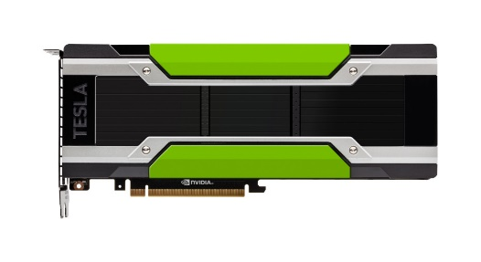
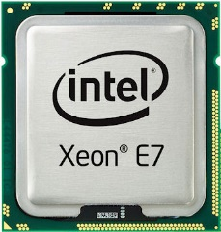
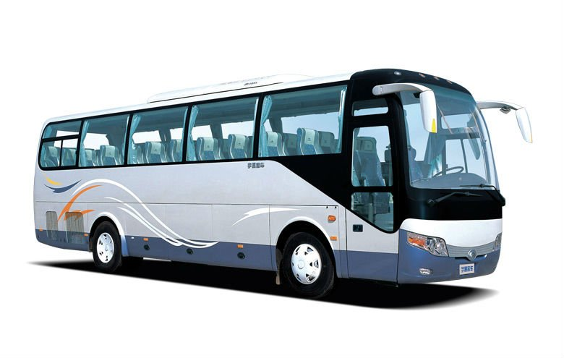
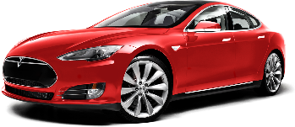
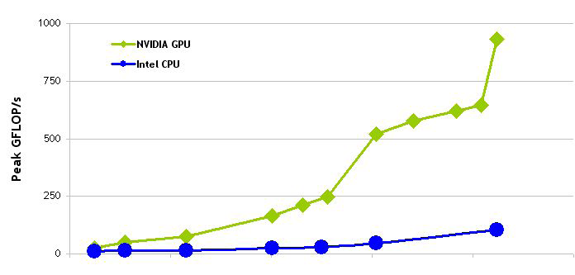
Key factors why Deep Learning became popular?
DL offers: accuracy, efficiency and flexibility.
Hardware:
GPU Power
massive parallelization of simple programs (kernels)
High memory bandwidth
Internally, DL is more is less matrix computations
Allow processing of large data
Algorithms:
Fancy new algorithms, e.g. DropOut, ReLU, …
Smarter initialization, e.g. Xavier
……
Software:
Just a bunch of lines
Many libraries available:
Caffe, Theano, TensorFlow, Torch, ….
vs
Notes:
NN had issues of vanishing gradient. ReLU and GPU and better initialization make this less of a problem

Slide 6
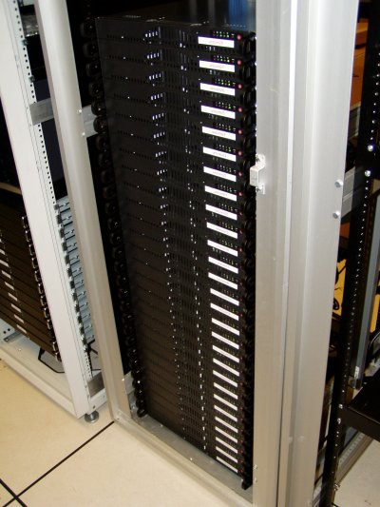
GPU vs CPU Processing Power
US$ 250
NVIDIA GPU
Peak GFlops
Intel CPU
2003 2004 2005 2006 2007 2008
(Source: NVIDIA CUDA Programming Guide)

Slide 7
Deep Learning frameworks at a glance
Caffe - Industry-grade deep learning toolkit
C++ based, with Python interface
Very fast and flexible
Focus on ConvNets
Popular in computer vision community
Limited support: for recurrent networks and language modeling
TensorFlow – Google‘s Deep Learning framework
Many state-of-the-art models
Python interface to highly optimized C++ algorithms
Symbolic graph of vector operations approach, specifying a new network is fairly easy
Theano - pioneered the trend of using symbolic graph for programming a network
State of the art models
Easy to learn and use
A bit hard to debug
A bit slow
Torch – Used by Google DeepMind, Facebook AI, IBM, …
State of the art models
Based on Lua programming language
Very fast

Slide 8
Theano
Symbolic computations python framework
Allows for GPU/CPU computation
Easy to use, e.g. no need to worry about pesky stuff like gradients
import theano
from theano import tensor
# declare two symbolic floating-point scalars
a = tensor.dscalar()
b = tensor.dscalar()
# create a simple expression
c = a + b
# convert the expression into a callable object that takes (a,b)
# values as input and computes a value for c
f = theano.function([a,b], c)
# bind 1.5 to 'a', 2.5 to 'b', and evaluate 'c'
assert 4.0 == f(1.5, 2.5)

Slide 9

Basics of Neural Networks

Slide 10
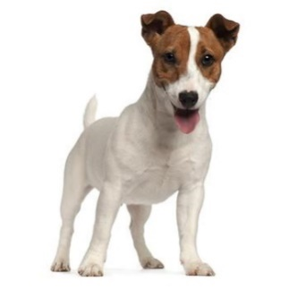
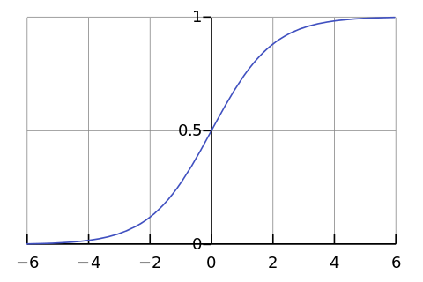
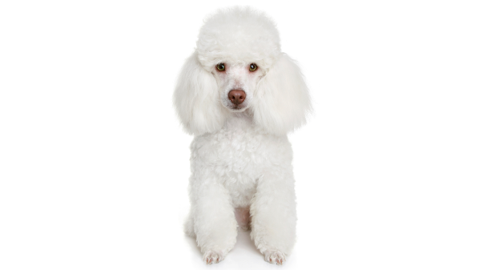
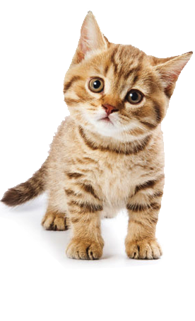
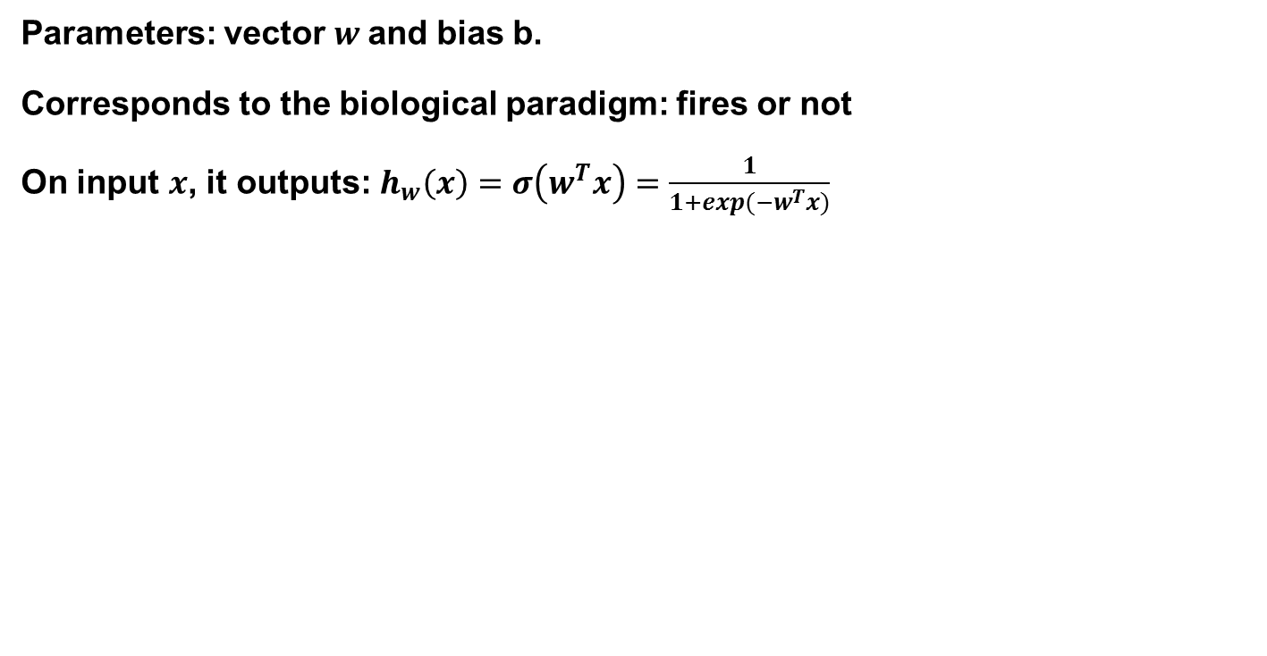
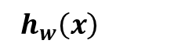
Logistic Regression / Perceptron
Parameters: vector $w$and bias b.
Corresponds to the biological paradigm: fires or not
On input $x$, it outputs: $h_{w}\left(x\right)=σ\left(w^{T}x\right)=\frac{1}{1+exp(−w^{T}x)}$
x₁
x₂
$h_{w}\left(x\right)$
x₃
x₄

Slide 11

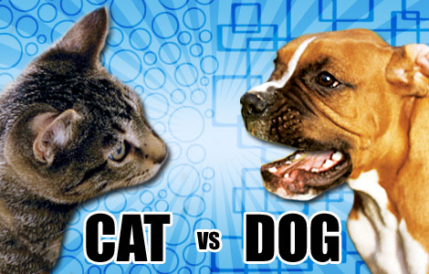
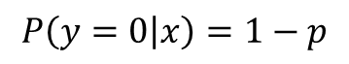
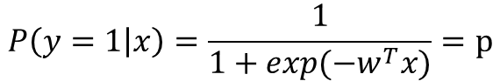
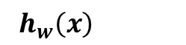
From single Perceptron to MLP
String together multiple logistic units (note: other activation functions are possible)
$$P\left(y=1 | x\right)=\frac{1}{1+exp(−w^{T}x)}=p$$
x₁
$$P\left(y=0 | x\right)=1−p$$
x₂
$h_{w}\left(x\right)$
x₃
Layer 3
x₄
Input
Layer 1 3
Layer 2 3

Slide 12
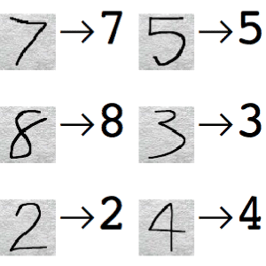
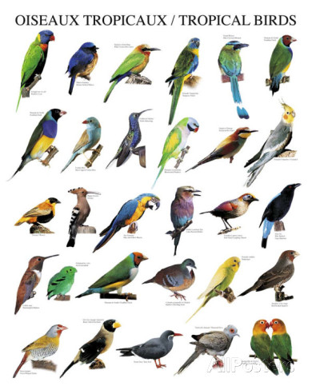
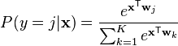
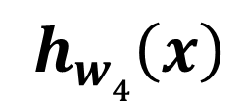
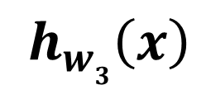
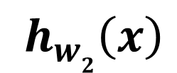
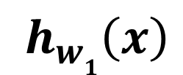
Handling multi-class? Almost the same thing
String together multiple logistic units
x₁
$h_{w1}\left(x\right)$
x₂
$h_{w2}\left(x\right)$
x₃
$h_{w3}\left(x\right)$
Layer 3
x₄
$h_{w4}\left(x\right)$
Input
Layer 1 3
Layer 2 3
Lots of parameters ……

Slide 13

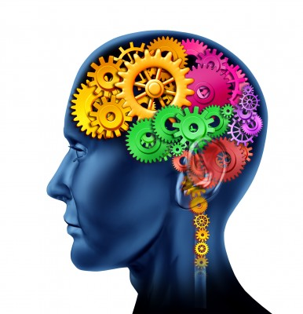

Essence of Deep Learning
object models
object parts
(combination
of edges)
edges
pixels

Slide 14
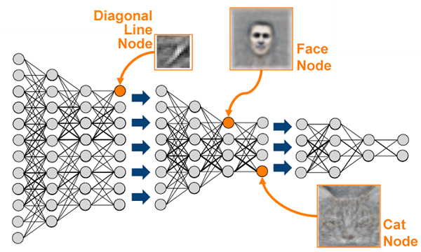
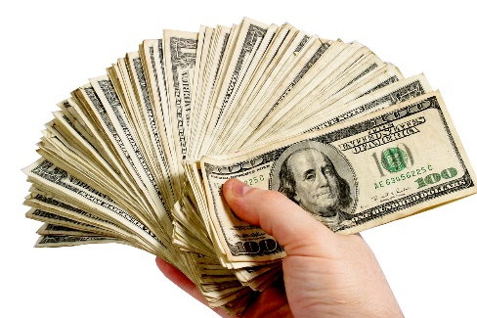
Deep Learning Network

Slide 15
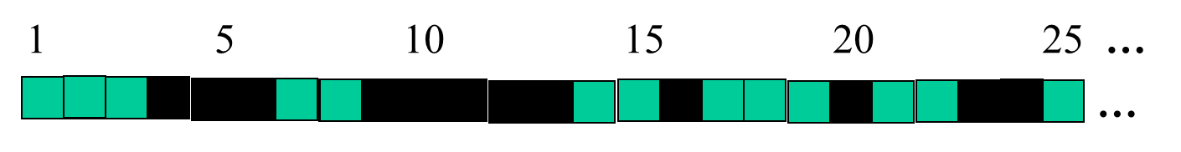
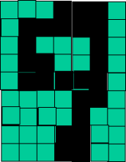
Example Handwritten Digit Classification
Lower level detectors:
detect lines in
Specific positions
etc …
Higher level detectors:
( horizontal line,
“RHS vertical line”
“upper loop”, etc…
etc …
v
What does this unit detect?

Slide 16

Training a (Deep) Neural Net

Slide 17
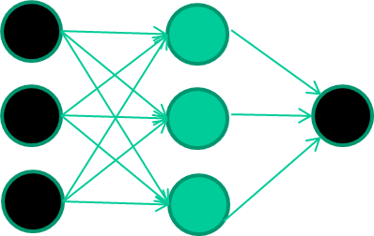
NN Training - Backpropagation
Training data
Fields class
1.4 2.7 1.9 0
3.8 3.4 3.2 0
6.4 2.8 1.7 1
4.1 0.1 0.2 0
etc …
Initialize with random weights
Model Parameters:
0.2
-0.5
0.7

Slide 18
NN Training
Training data
Fields class
1.4 2.7 1.9 0
3.8 3.4 3.2 0
6.4 2.8 1.7 1
4.1 0.1 0.2 0
etc …
Present a training pattern
1.4
2.7
1.9
Model Parameters:
0.2
-0.5
0.7

Slide 19
NN Training
Training data
Fields class
1.4 2.7 1.9 0
3.8 3.4 3.2 0
6.4 2.8 1.7 1
4.1 0.1 0.2 0
etc …
Feed it through to get output
1.4
2.7 0.8
1.9
Model Parameters:
0.2
-0.5
0.7
Forward Pass

Slide 20
NN Training
Training data
Fields class
1.4 2.7 1.9 0
3.8 3.4 3.2 0
6.4 2.8 1.7 1
4.1 0.1 0.2 0
etc …
Compare with target output
1.4
2.7 0.8
0
1.9 error 0.8
Model Parameters:
0.2
-0.5
0.7

Slide 21


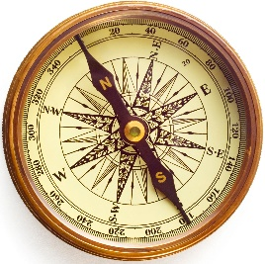
NN Training
Training data
Fields class
1.4 2.7 1.9 0
3.8 3.4 3.2 0
6.4 2.8 1.7 1
4.1 0.1 0.2 0
etc …
Adjust weights based on error
1.4
2.7 0.8
0
1.9 error 0.8
Model Parameters:
0.22
-0.45
0.68
Backward Pass

Slide 22
NN Training
Training data
Fields class
1.4 2.7 1.9 0
3.8 3.4 3.2 0
6.4 2.8 1.7 1
4.1 0.1 0.2 0
etc …
Present a training pattern
6.4
2.8
1.7
Model Parameters:
0.22
-0.45
0.68

Slide 23
NN Training
Training data
Fields class
1.4 2.7 1.9 0
3.8 3.4 3.2 0
6.4 2.8 1.7 1
4.1 0.1 0.2 0
etc …
Feed it through to get output
6.4
2.8 0.9
1.7
Model Parameters:
0.22
-0.45
0.68

Slide 24
NN Training
Training data
Fields class
1.4 2.7 1.9 0
3.8 3.4 3.2 0
6.4 2.8 1.7 1
4.1 0.1 0.2 0
etc …
Compare with target output
6.4
2.8 0.9
1
1.7 error -0.1
Model Parameters:
0.22
-0.45
0.68

Slide 25
NN Training
Training data
Fields class
1.4 2.7 1.9 0
3.8 3.4 3.2 0
6.4 2.8 1.7 1
4.1 0.1 0.2 0
etc …
Adjust weights based on error
6.4
2.8 0.9
1
1.7 error -0.1
Model Parameters:
0.217
-0.448
0.62

Slide 26
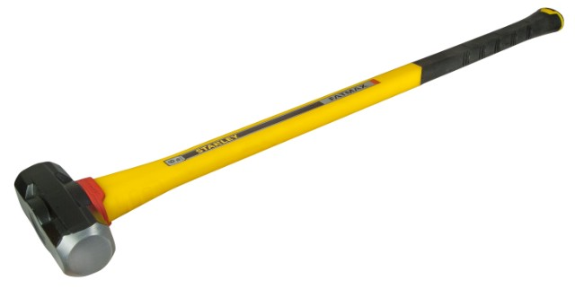

NN Training
Training data
Fields class
1.4 2.7 1.9 0
3.8 3.4 3.2 0
6.4 2.8 1.7 1
4.1 0.1 0.2 0
etc …
And so on ….
Notes:
Repeat this thousands, maybe millions of times – each time taking a random training instance, and making slight weight adjustments
Algorithms for weight adjustment are designed to make changes that will reduce the error

Slide 27
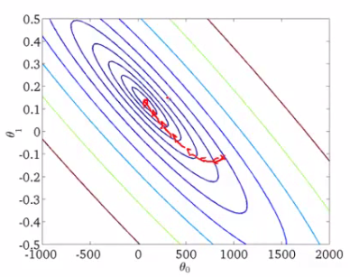
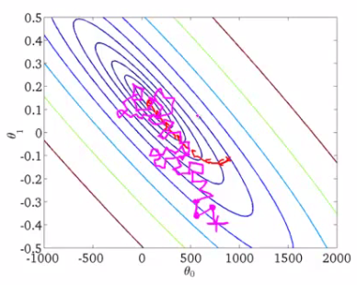
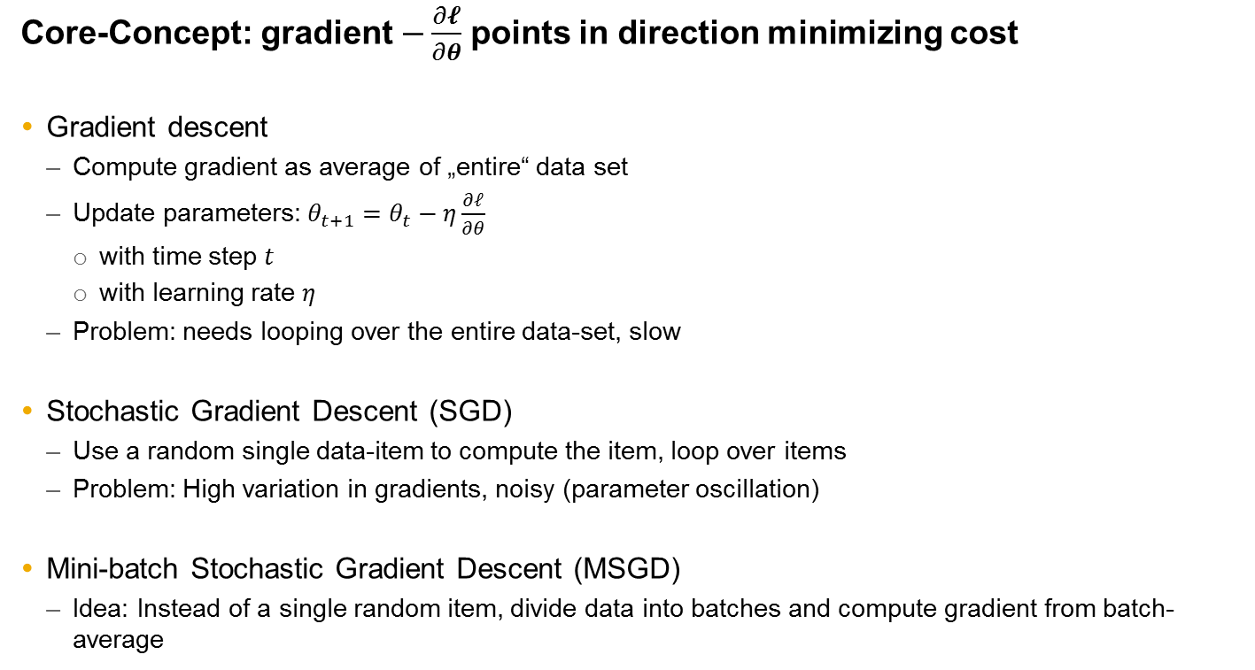
Learning the model | Mini-batch Stochastic Gradient Descent (MSGD)
Core-Concept: gradient $−\frac{∂𝓵}{∂θ}$ points in direction minimizing cost
Gradient descent
Compute gradient as average of „entire“ data set
Update parameters: $θ_{t+1}=θ_{t}−η\frac{∂𝓁}{∂θ}$
with time step $t$
with learning rate $η$
Problem: needs looping over the entire data-set, slow
Stochastic Gradient Descent (SGD)
Use a random single data-item to compute the item, loop over items
Problem: High variation in gradients, noisy (parameter oscillation)
Mini-batch Stochastic Gradient Descent (MSGD)
Idea: Instead of a single random item, divide data into batches and compute gradient from batch-average
Notes:
SGD converges faster than normal "batch" gradient descent because it updates the weights after looking at a randomly selected subset of the training set, however, higher variation (oscillation) due to noise
GD very slow, less variation, very expensive as it is computed for the entire data-set
MSGD is a compromise

Slide 28
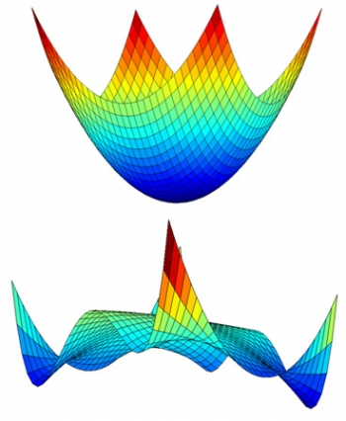

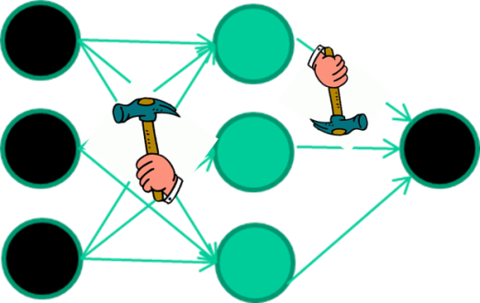
Summary Training a Neural Net
Weight-learning algorithms for NNs are dumb
Solution depending on initialization
Highly non-convex optimization problem, no guarantee we obtain global optimum
Numerous (millions …billions) of tiny adjustments and lots of data needed
Each making the network do (hopefully) better at the most recent pattern, but perhaps a little worse on many others
Eventually good enough to learn effective classifiers for many real applications

Slide 29
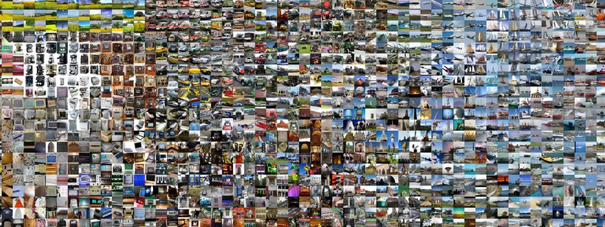
Convolutional Neural Networks (CNN)

Slide 30
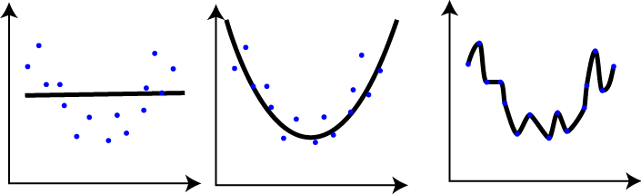

Convolutional Neural Network (CNN)
Special neural net
Explicit assumption that the inputs are images
Basic operatios: Convolution & Pooling
Reduced number of parameters
Replicated weights used across image domain
Same feature occurs multiple times
Max-Pooling: Partitions image into non-overlapping, for each such sub-region only keep maximum value
Advantageous properties e.g. shift-invariance, efficiency

Slide 31
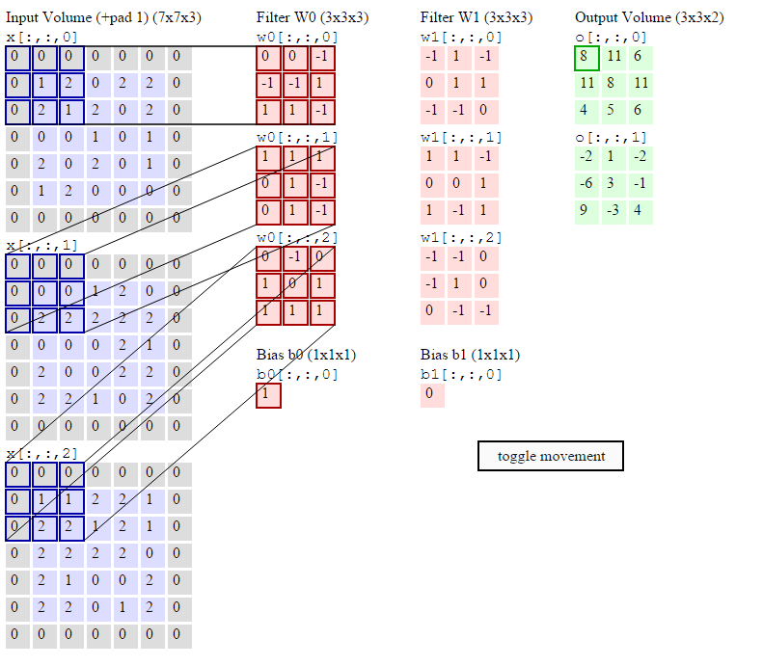
Convolution – Filters for optimal feature representation

Slide 32
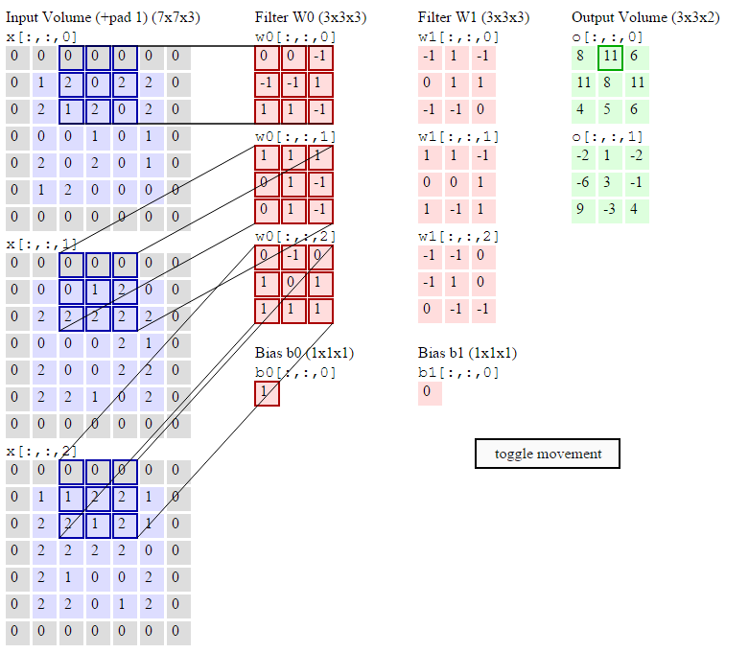
Convolution

Slide 33
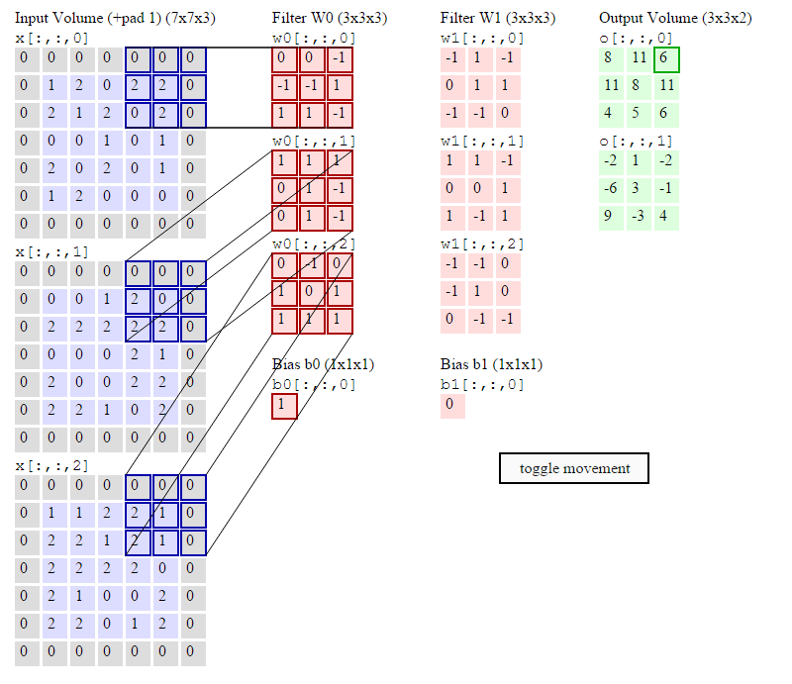
Convolution

Slide 34
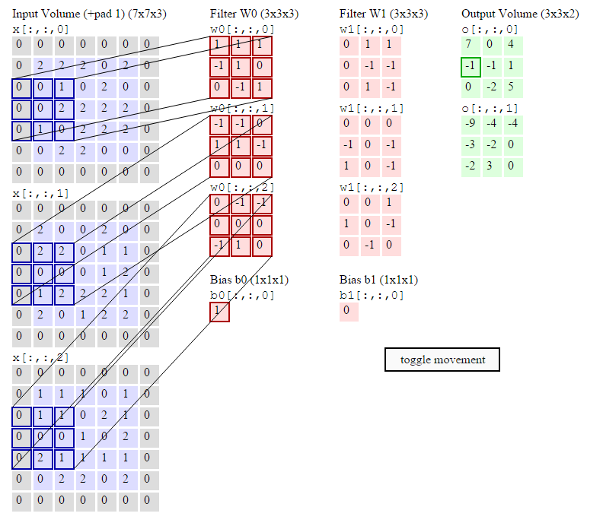
Convolution

Slide 35
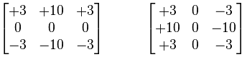
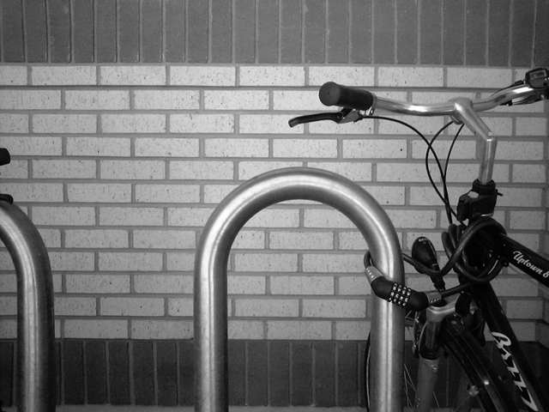
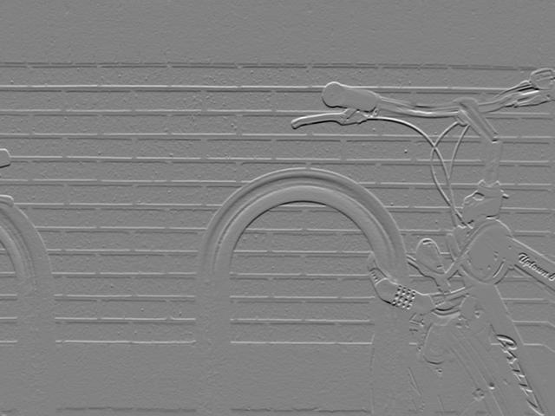
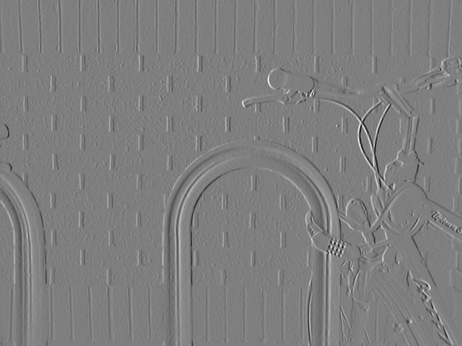

Example Convolution

Slide 36

Max-Pooling – Keep informative parts
Example: window size 2

Slide 37

CNN Filters

Slide 38
Hands-on: Handwritten Digit Classification MLP vs CNN

Slide 39

Recurrent Neural Networks (RNNs)

Slide 40

Recurrent Neural Network (RNN)
In their simplest form RNNs are just NNs with a feedback loop
Basic functionality: process data series
Use of internal memory / state
Training slightly more or less identical to NN training
Unroll RNN through time to get a NN
Backpropagation through time (BPTT)
Applications:
Text analysis: predict next word, word classification, …
Time series: sensor data, financial market, ….

Slide 41

RNNs continued
Sequences in input and/or output:
Sequence Output:
e.g. image to text (word series)
Sequence Input:
e.g. text sentiment analysis
Sequence In/Out:
e.g. text translation

Slide 42


RNN continued
Vanishing gradient problem
How about more complex models?
There are various e.g. longer memory etc.
More fancy algorithm used in real applications: Long Short-Term Memory
Can we use RNN in a deep learning fashion?
Yes, we can (e.g. stack them up)

Slide 43


Hands-on: Word classification

Slide 44
Thank you
Contact information:
Tassilo Klein

